Slide 1


How to Program Your Dragon
Notes:
Welcome to That Conference 2018 and the session How to Program your Dragon. There are two worksheets on the tables one is a dragon quiz and the other is a HTML and CSS worksheet.

Slide 2


Slide 3


Slide 4
About Rebecca
I am going to be a Senior at Kettle Moraine High School in Wisconsin. I'm 18 years old. I enjoy taking programming courses at my high school to help me pursue my dream of becoming a computer programmer. I have been attending That Conference since the beginning and I have enjoyed every year of it. I am a member of the National Honor Society and a member of my school’s band. Outside of school I also work at a nursing home in my area. In my free time I volunteer at my church, ride horses and love to watch anime.
Notes:
My name is Rebecca Von Ruden and I am a Senior at Kettle Moraine High School in Wisconsin. I just turned 18 years old.

Slide 5
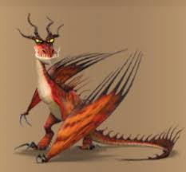


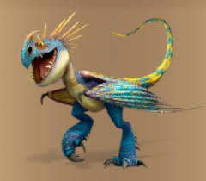
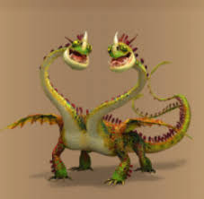

Who is your Favorite Dragon?
Notes:
If you do not have a favorite dragon I have a quiz on the tables to help you pick the dragon you want to do your website on. (Give kids time to respond to the question. Candy will be given out for answers)

Slide 6
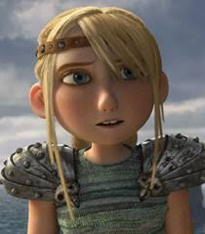
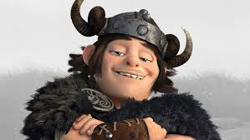



Who is your Favorite Viking
Notes:
Allow time for kids to respond and give out candy for answers.

Slide 7

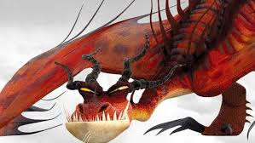
Let’s Start Programming a Website for Your Dragon
Notes:
Show my webpage to kids. Link: "C:\Dev\ProgramYourDragon\index.html"

Slide 8
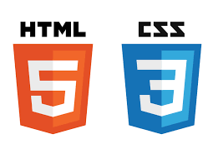

What are HTML and CSS?
What is HTML in your own words?
What is CSS in your own words?
Notes:
If I don’t get a correct response explain what HTML and CSS are. HTML is a standard programming language for creating web pages. CSS describes how HTML is to be displayed on the webpage.

Slide 9

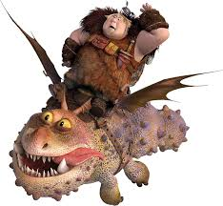

What is Index.html used for?
What is a tag in HTML?
Notes:
Name used for home page of a website

Slide 10
Tags in HTML
Component of HTML that commands what you want to happen.
<title> Dragon webpage </title>

Slide 11
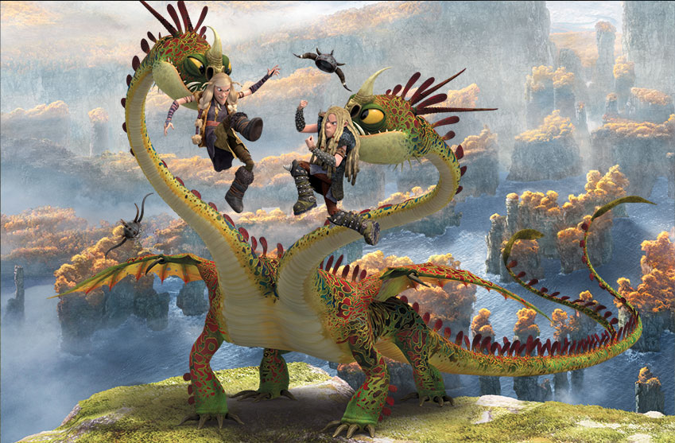
Parts of HTML Covered Today
<Head> where the title of the web page is </Head>
<title>what your website says on the tab</title>
<Body> where everything on the web page needs to be placed </Body>
<p> paragraph of text </p>
<img src=“Monster.jpg”> a picture you put on the Website </img>
<a href=https://www.howtotrainyourdragon.com/> link to another page</a>
<strong> bold text</strong>
Notes:
HTML and CSS cheat sheet are on the tables.
<p> means paragraph, <img> means image

Slide 12
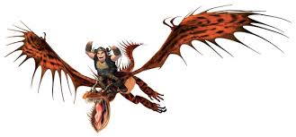
Parts of HTML
<ul> starts a list of bullet points</ul>
<li> item in the list </li> (must be put inside ul tags)
<h1> large text </h1>
<style> allows you to put CSS inside the HTML page </style>
Notes:
<ul> means unordered list, <li> means list item, <h1> means heading 1, explain tags!!!

Slide 13

How to Create a HTML Document
Create new file
Save as index.html
On the first line write <!DOCTYPE html>
Create <html> </html> tags (put code inside html tags)
Notes:
Go through these steps with the kids give time for the steps to be done. The format is also on the cheat sheet on the tables as well.
HTML does not show errors. Remove the defalt txt.

Slide 14

Parts of CSS Covered Today
Changing color of background body{background:red}
Change color of font p{color:purple}
How to change location of text body{margin:200}
How to change font size body{font-size:28px}
Notes:
There are more colors on HTML and CSS cheat sheet along with a link to help you find colors you like. All the examples are on the cheat sheet for both CSS
and HTML. Explain syntatx

Slide 15


Slide 16
Resources and Links
HTML: http://www.goodellgroup.com/tutorial/chapter1.html
How to Train your Dragon: http://howtotrainyourdragon.wikia.com/wiki/How_to_Train_Your_Dragon_Wiki
CSS Color Picker: https://www.w3schools.com/colors/colors_picker.asp
GitHub: https://github.com/RebeccaVonRuden/ProgramYourDragon
Notes:
Thank you for coming to my session How to Program your Dragon.

